Slide 1
What is Nanotechnology
the study of the controlling of matter on an atomic and molecular scale. Generally nanotechnology deals with structures sized between 1 to 100 nanometer in at least one dimension, and involves developing or modifying materials or devices within that size.

Slide 2
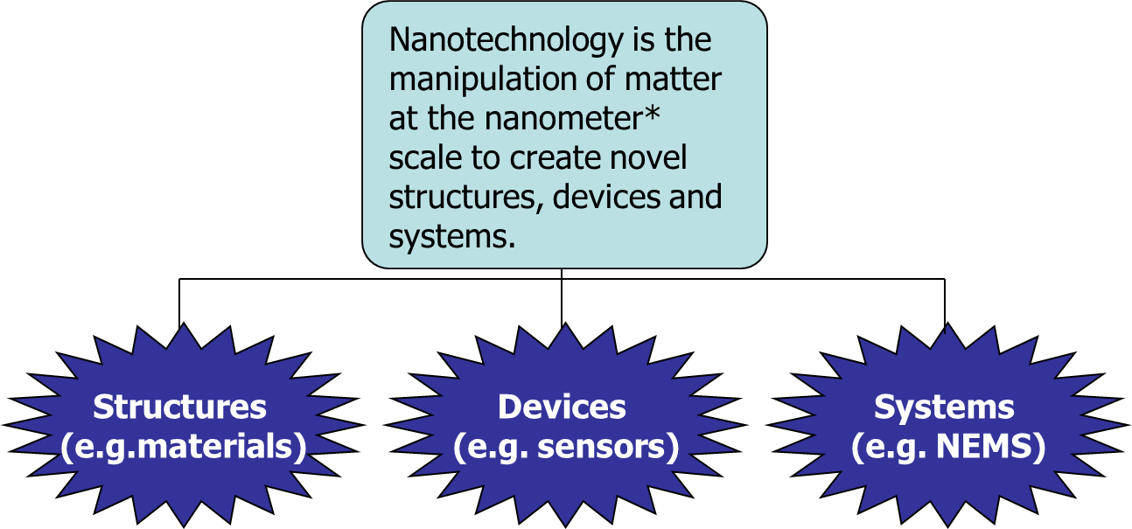

Slide 3
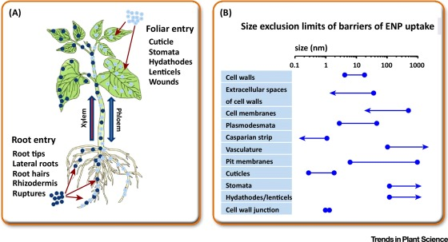

Slide 4
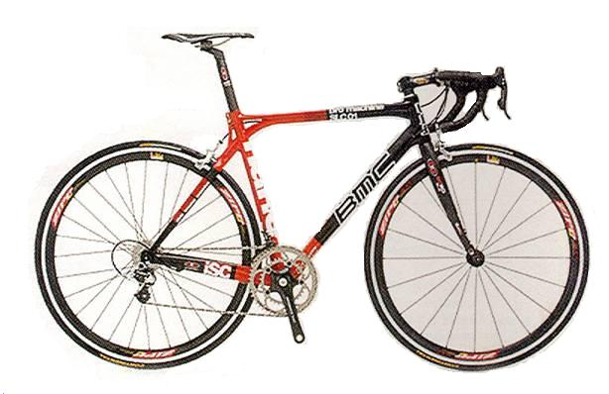
Nanotechnology
is already making today’s products:
Lighter
Stronger
Faster
Smaller
More Durable

Slide 5
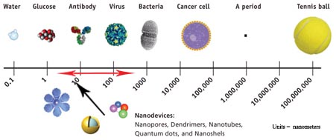
How small is Nano - small?
Units in nanometers (µm)

Slide 6
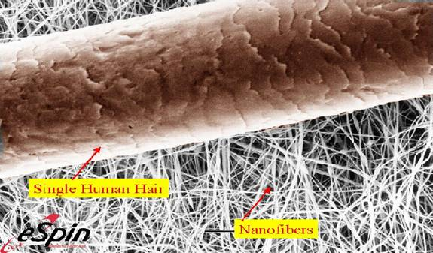
Compared to Human Hair
A Human Hair is about 100,000µm wide

Slide 7
A “Nano-Scale” Demonstration
http://screencast.com/t/MzAxODc5
http://screencast.com/t/MGMxZTcyN2E

Slide 8
Nanotechnology spans many Areas
Information
Technology
Information
Technology
Information
Technology
Information
Technology
Information
Technology
Information
Technology
Information
Technology
Information
Technology
Information
Technology
Information
Technology
Information
Technology
Information
Technology
Mechanical Eng. &
Robotics
Mechanical Eng. &
Robotics
Mechanical Eng. &
Robotics
Mechanical Eng. &
Robotics
Mechanical Eng. &
Robotics
Mechanical Eng. &
Robotics
Mechanical Eng. &
Robotics
Mechanical Eng. &
Robotics
Mechanical Eng. &
Robotics
Mechanical Engineering /
Robotics
Biotechnology
Biotechnology
Biotechnology
Biotechnology
Biotechnology
Biotechnology
Biotechnology
Biotechnology
Transportation
Transportation
Transportation
Transportation
Advance
Materials & Textiles
Advance
Materials & Textiles
Advance
Materials & Textiles
Advance
Materials & Textiles
Advance
Materials & Textiles
NANOTECHNOLOGY
NANOTECHNOLOGY
NANOTECHNOLOGY
NANOTECHNOLOGY
NANOTECHNOLOGY
NANOTECHNOLOGY
NANOTECHNOLOGY
NANOTECHNOLOGY
NANOTECHNOLOGY
NANOTECHNOLOGY
NANOTECHNOLOGY
NANOTECHNOLOGY
NANOTECHNOLOGY
NANOTECHNOLOGY
National
Security &
Defense
National
Security &
Defense
National
Security &
Defense
National
Security &
Defense
National
Security &
Defense
National
Security &
Defense
Energy &
Environment
Energy &
Environment
Energy &
Environment
Energy &
Environment
Energy &
Environment
Energy &
Environment
Energy &
Environment
Energy &
Environment
Energy &
Environment
Food and
Agriculture
Food and
Agriculture
Food and
Agriculture
Food and
Agriculture
Food and
Agriculture
Food and
Agriculture
Food and
Agriculture
Food and
Agriculture
Food and
Agriculture
Food and
Agriculture
Food and
Agriculture
Food and
Agriculture
Food and
Agriculture
Food and
Agriculture
Food and
Agriculture
Medicine /
Health
Medicine /
Health
Medicine /
Health
Medicine /
Health
Medicine /
Health
Medicine /
Health
Medicine /
Health
Medicine /
Health
Medicine /
Health
Medicine /
Health
Medicine /
Health
Medicine /
Health
Medicine /
Health
Medicine /
Health
Aerospace
Medicine /
Health
Aerospace
Aerospace
Aerospace
Aerospace
Aerospace
Aerospace
Aerospace
Aerospace
Aerospace
Aerospace
Aerospace
Aerospace
Aerospace
Aerospace

Slide 9
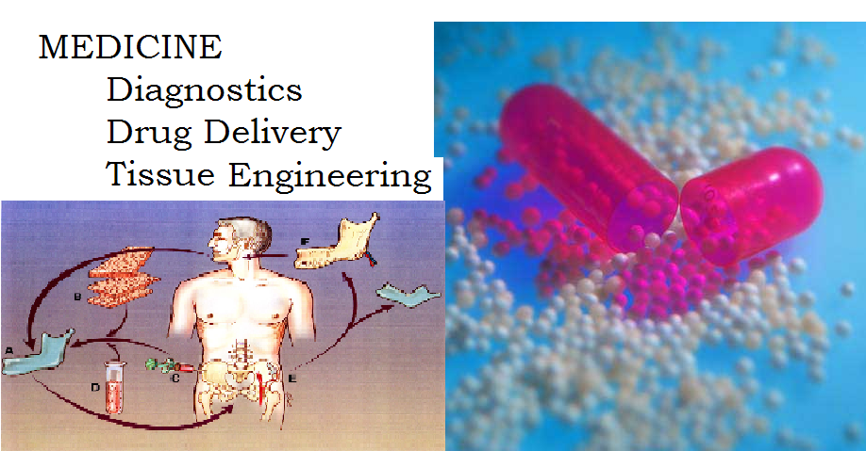
Applications of Nanotechnology

Slide 10
Current Applications
burn and wound dressings, water filtration devices, paints, cosmetics, coatings, lubricants, textiles, memory/storage devices
medical diagnostics, displays, sensors, drug delivery, composite materials, solid state lighting, bio-materials, nano arrays, more powerful computers, protective armor, chem-bio suits, and chem-bio sensors

Slide 11
Future Applications
2011-15 -- nanobiomaterials, microprocessors, new catalysts, portable energy cells, solar cells, tissue/organ regeneration, smart implants
2016 and beyond – molecular circuitry, quantum computing, new materials, fast chemical analyses

Slide 12
Microscopy
Scientists use microscopes to visualize cells too small to see with the naked eye
In a light microscope (LM), visible light is passed through a specimen and then through glass lenses
Lenses refract (bend) the light, so that the image is magnified

Slide 13
Two basic types of electron microscopes (EMs) are used to study subcellular structures
Scanning electron microscopes (SEMs) focus a beam of electrons onto the surface of a specimen, providing images that look 3-D
Transmission electron microscopes (TEMs) focus a beam of electrons through a specimen
TEMs are used mainly to study the internal structure of cells

Slide 14
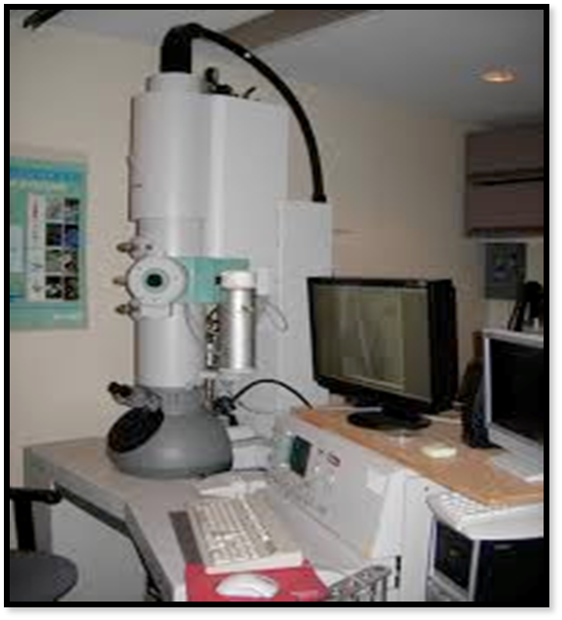
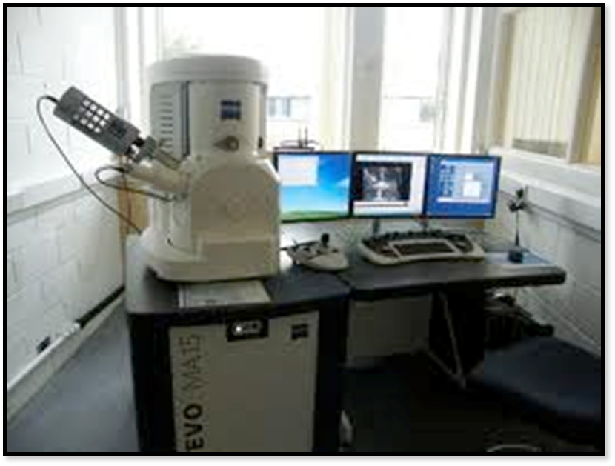

Slide 15
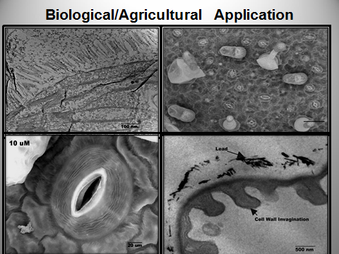

Slide 16
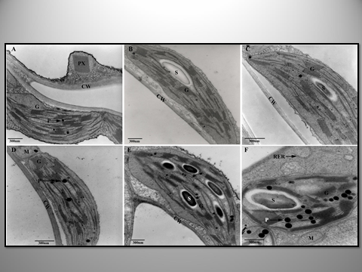

Slide 17
